Slide 1
Implementation of Minimax and Alpha-Beta Pruning Algorithms in a Chess Environment

Slide 2
Performance Comparison and Explanation
Minmax Algorithm Characteristics:
Basic Operation:
Explores all possible moves recursively to a given depth
Alternates between maximizing (our moves) and minimizing (opponent's moves)
Performance:
Time complexity: O(b^d) where b is branching factor (~35 in chess), d is depth
For depth=3: ~35^3 = 42,875 nodes evaluated
No pruning - evaluates every possible node in the search tree
Consistent but slow for deeper searches

Slide 3
Evaluation Function
Checks if the game is over (checkmate, stalemate, etc.)
Returns large positive value for white win, large negative for black win
Returns 0 for draws (stalemate, insufficient material, etc.)
Uses standard chess piece values (pawn=1, knight=3, etc.)
Bishop slightly higher than knight (3.25 vs 3) as it's generally stronger in open positions
Calculates material advantage by counting pieces for both sides
Positive values indicate white's advantage, negative values black's advantage
Adds a small bonus (0.1 per move) for number of legal moves
Encourages the AI to maintain active pieces and control of the board
Helps avoid passive positions where pieces have limited movement
Returns score from the perspective of the current player
If it's black's turn, inverts the score (since positive values favor white)
Ensures the evaluation makes sense for whichever side is about to move

Slide 4
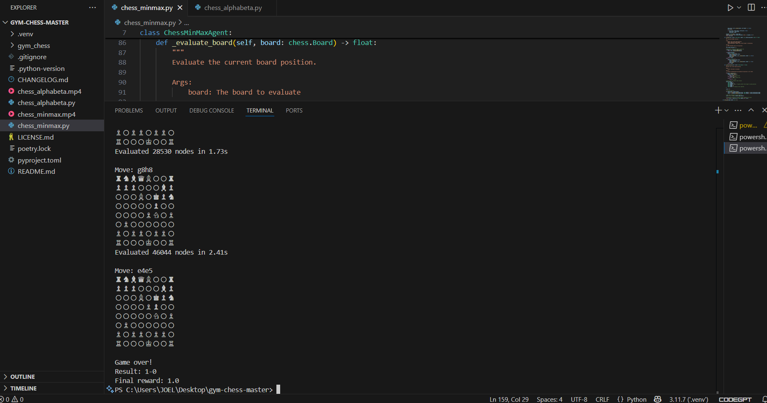
Results

Slide 5
Alpha-Beta Pruning Characteristics:
Basic Operation:
Same as Minmax but with pruning of irrelevant branches
Maintains alpha (best value for maximizer) and beta (best value for minimizer)
Prunes when it finds a move worse than previously found one (beta <= alpha)
Performance:
Time complexity: O(b^(d/2)) in best case (with perfect move ordering)
For depth=3: ~35^1.5 ≈ 207 nodes evaluated in best case
Typically reduces nodes by 50-90% in practice
Effectiveness depends on move ordering (better moves first = more pruning)

Slide 6
Evaluation Function
First checks if the game has ended
+1000 for white win
-1000 for black win
Rewards positions with more available moves
0.1 per legal move
Kept small (0.1) to avoid overvaluing mobility vs material
Isolated pawns: Penalty (-0.5) for pawns with no friendly pawns on adjacent files
Passed pawns: Bonus (+1.0) for pawns with no opposing pawns that can stop them
Pawn shield: Bonus (+0.5 per pawn) for protective pawns near king
Open file penalty: Penalty (-0.75) when king is on a file with no pawns
Material (60-70% weight)
Positional factors (30-40% weight)
All evaluations consider both colors equally

Slide 7
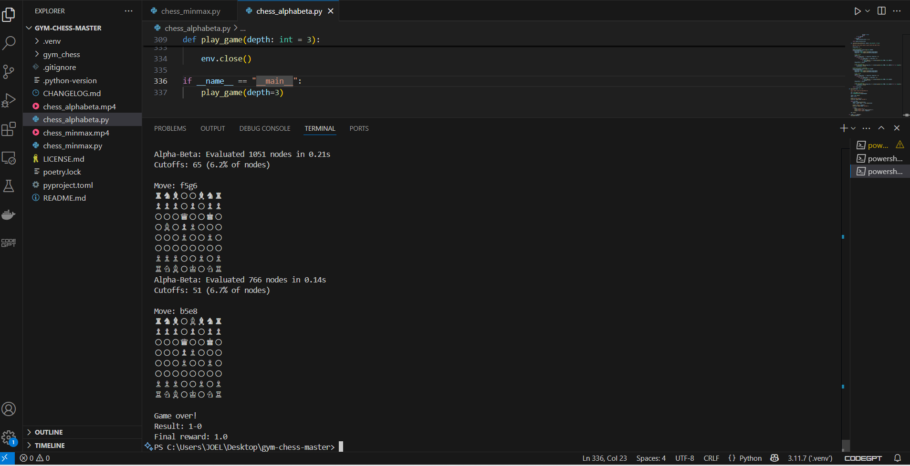
Result

Slide 8
Key Differences:
Characteristic | MinMax | Alpha-Beta Pruning
Nodes Evaluated | All nodes (b^d) | Many fewer (b^(d/2) in best case
Speed | Slower | Much faster
Move Quality | Same as Alpha-Beta | Identical to MinMax
Implementation | Simpler | Slightly more complex
Move Ordering | Doesn't matter | Critical for performance
Best Case | N/A | Can approach sqrt(b^d) nodes

